Slide 1
Discover India: Your Gateway to Culture & Heritage

Slide 2

The Vision: Connecting the World to India's Rich Tapestry
Our vision is to be the premier digital bridge connecting global travellers and enthusiasts to the unparalleled cultural and historical wealth of India. We aim to inspire a deeper appreciation for India's heritage, making its wonders accessible to all.
Through immersive experiences and comprehensive information, we foster a worldwide community that celebrates the spirit of India.

Slide 3
What is Discover India? (Overview of our Web Platform)
Detailed Information
Comprehensive guides on historical sites, cultural practices, and local traditions.
Interactive Exploration
Virtual tours, 360-degree views, and multimedia content bringing India to life.
Seamless Bookings
Integrated platform for hassle-free trip planning, accommodation, and transport.
Curated Experiences
Unique itineraries focusing on authentic cultural immersion and local engagement.

Slide 4
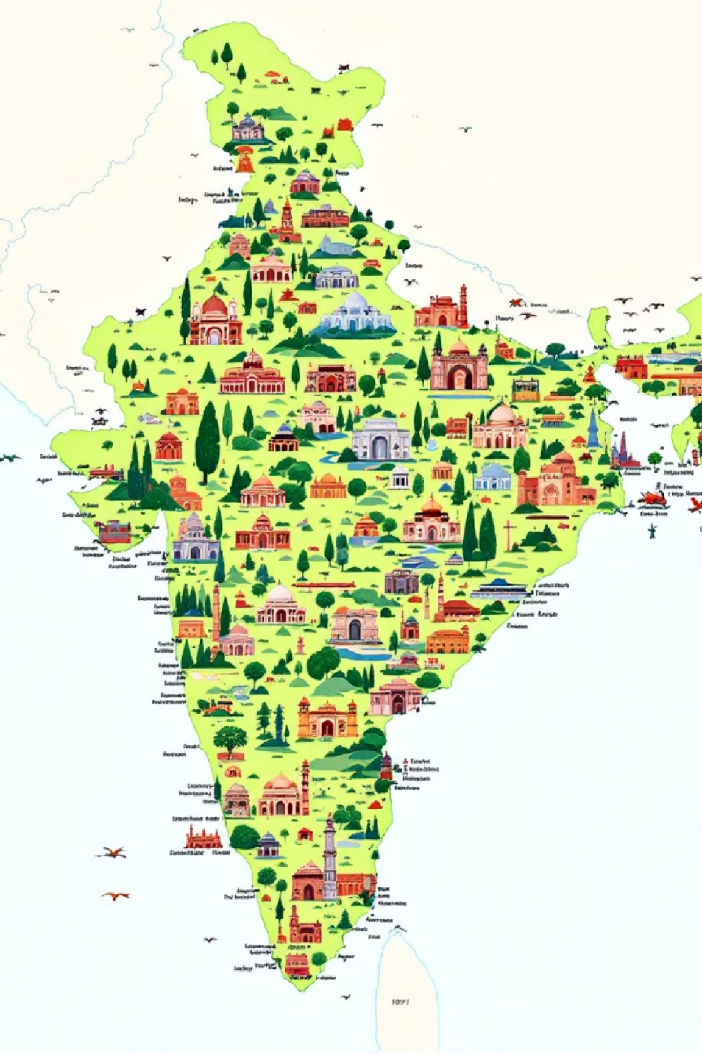




Unveiling India's Treasures: Detailed Place Information
Historical Monuments
Explore iconic structures like the Taj Mahal, Red Fort, and Hampi, with rich historical narratives and architectural details.
Spiritual Sanctuaries
Discover ancient temples, serene monasteries, and revered pilgrimage sites, understanding their spiritual significance.
Natural Wonders
Journey through diverse landscapes, from the Himalayan peaks to the Kerala backwaters, and vibrant wildlife reserves.
Vibrant Cities
Navigate bustling metropolitan areas and charming towns, each offering a unique blend of modernity and tradition.

Slide 5
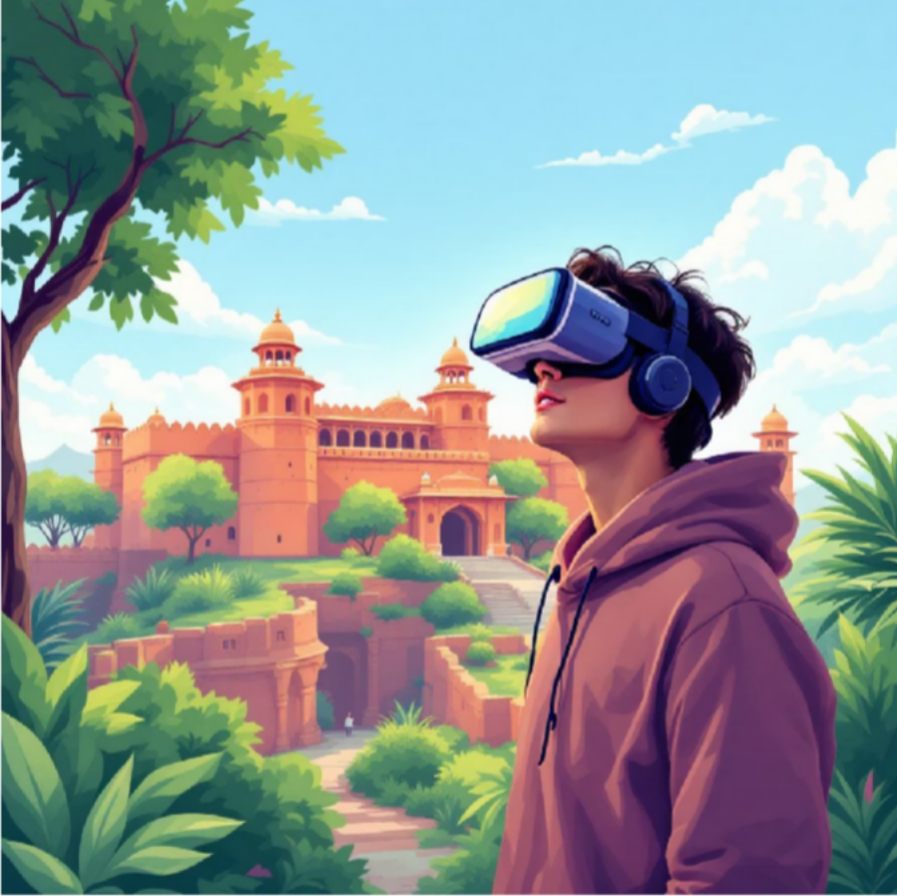
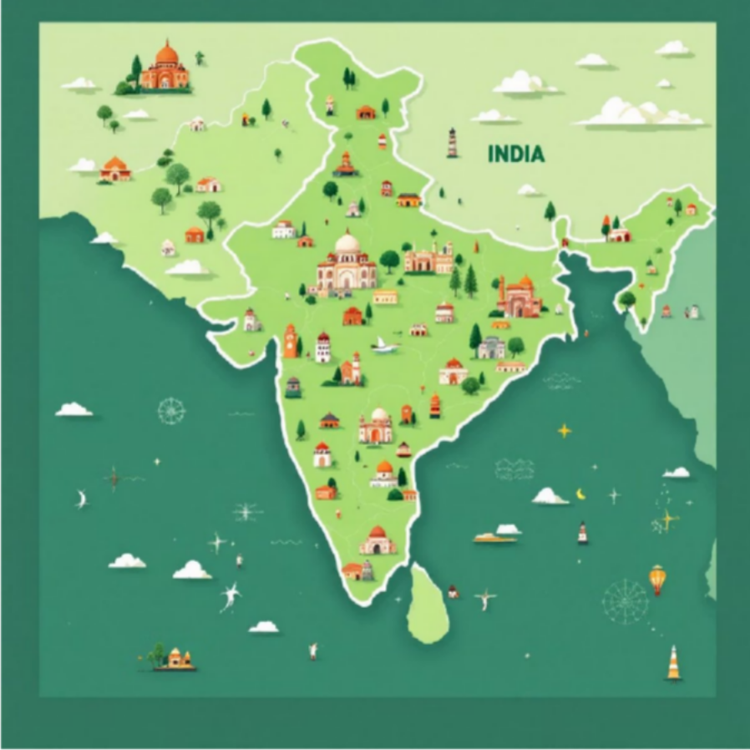
Interactive Exploration: Immersive Journeys from Your Screen
Virtual Reality Tours
Dynamic Maps & Guides
Step into the past with VR experiences of ancient ruins and bustling bazaars. Our 360-degree views transport you directly to the heart of India's most captivating locations, offering an unparalleled sense of presence.
Utilise our intuitive, zoomable maps featuring detailed points of interest, historical overlays, and curated walking routes. Each click reveals layers of information, making planning and exploration effortless.
Experience India's beauty and history like never before, all from the comfort of your home.

Slide 6




Seamless Travel: Trip Planning & Booking Made Easy
Flight & Train Bookings
Compare and book domestic and international travel options with real-time availability and competitive pricing.
Accommodation Solutions
From luxury hotels to heritage stays and budget-friendly guesthouses, find the perfect place to rest.
Local Transport & Guides
Arrange for car rentals, private transfers, and certified local guides for a smooth and informative journey.
Our integrated platform ensures every aspect of your travel planning is simplified and stress-free, from departure to arrival.

Slide 7

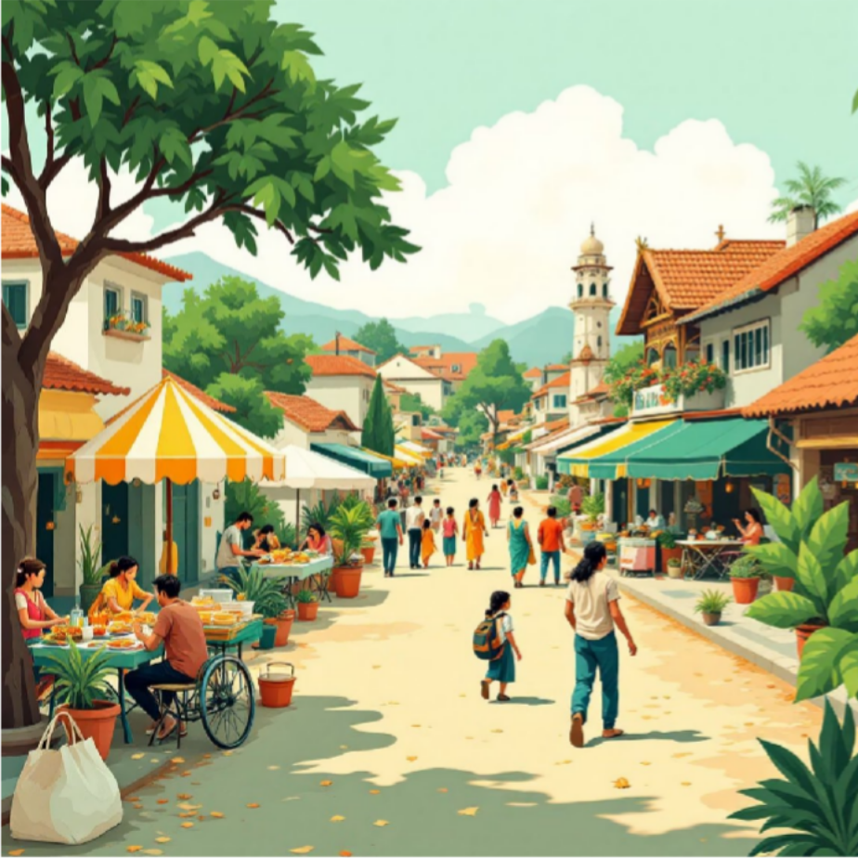
Curated Experiences: Beyond Sightseeing, Into the Heart of India
Cultural Workshops
Local Immersion Tours
Engage in hands-on experiences like traditional cooking classes, pottery workshops, and classical dance lessons to truly immerse yourself.
Participate in authentic village tours, festival celebrations, and street food safaris, connecting with local communities and their way of life.
Discover India offers unique itineraries designed to provide profound cultural insights and unforgettable memories.

Slide 8

Technology Behind the Magic: How We Bring India to Life
Cloud Infrastructure
Robust and scalable cloud solutions for seamless performance and global
accessibility.
AI-Powered Personalisation
Personalised recommendations for destinations and experiences based on user preferences.
Secure Payment Gateways
Ensuring safe and encrypted transactions for all bookings and
purchases.
Advanced VR/AR Integration
Cutting-edge virtual and augmented reality features for immersive exploration.
Leveraging the latest technology to deliver a superior, secure, and engaging user experience.

Slide 9
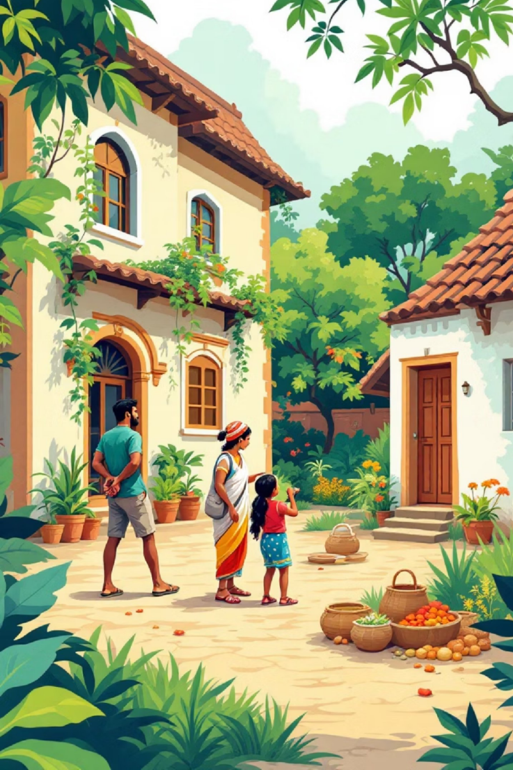
Our Impact: Preserving Heritage, Empowering Local Communities
Heritage Preservation
A portion of every booking contributes to the conservation and restoration of India's historical sites.
Economic Empowerment
Supporting local artisans, guides, and small businesses through direct engagement and fair practices.
Cultural Exchange
Facilitating meaningful interactions between travellers and local communities, fostering mutual understanding.
Discover India is committed to responsible tourism that benefits both visitors and the vibrant communities they explore.

Slide 10

Journey Onward: Q&A and Future of Discover India
Enhanced Personalisation
Further refining AI to offer even more tailored travel experiences and recommendations.
Expand Destinations
Adding more hidden gems and lesser-known regions to our platform for broader exploration.
Global Partnerships
Collaborating with international tourism bodies to promote Indian culture worldwide.
Community Features
Introducing forums and social functionalities for travellers to share experiences and tips.
Thank you! We invite your questions and look forward to shaping the future of cultural travel together.

